Slide 1
Chapter 6
Lists and Strings
Implementation of Lists
Strings
Linked Lists in Arrays

Slide 2
Lists
How are data related to each other and what operations are needed?
Stack Queue General List
Sequential
Push on top
Pop from top
Is empty
Sequential
Add to back
Take from front
Is empty
Sequential
Add anywhere
Take from anywhere
Is empty

Slide 3
Specifications for List
Construct the list, leaving it empty
Determine whether list is empty or not
Determine whether the list is full or not
Find the size of the list
Clear the list to make it empty
Insert an entry at a specified position of the list
Remove an entry from a specified position in the list
Retrieve the entry from a specified position in the list
Replace the entry at a specified position in the list
Traverse the list, performing a given operation on each entry.

Slide 4
Standard Template Library
Copyright @ 1996
Silicon Graphics Computer Systems, Inc.
The Standard Template Library, or STL, is a C++ library of
container classes, algorithms, and iterators; it provides many of the basic algorithms and data structures of computer science.
The STL is a generic library, meaning that its components are heavily parameterized: almost every component in the STL is a template. You should make sure that you understand how templates work in C++ before you use the STL.
--STL Help Files

Slide 5
Text vs STL
Textbook List
STL does not support random access to list elements
STL list supports operations that can be implemented efficiently (double linked list)
STL Vector
STL List

Slide 6

Constructor
List::List();
postconditon: The List has been created and is initialized to be empty.

Slide 7

Reinitialization
void List::clear();
postconditon: All List entries have been removed; the List is empty.

Slide 8

Is it empty?
bool List::empty()const;
postconditon: The function returns true or false according to whether the List is empty or not.
Empty?

Slide 9
Is it full?
bool List::full()const;
postconditon: The function returns true or false according to whether the List is full or not.
Full?

Slide 10
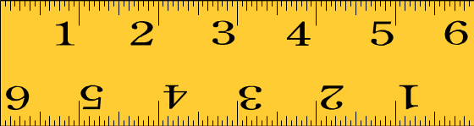
How many objects are in the List?
int List::size()const;
postconditon: The function returns the number of entries in the List.

Slide 11

Accessing Objects in the List
Use an integer, as with an array subscript
Same method regardless of implementation
If an object is added at position k then objects in positions k through the end of the list have indexes incremented
If an object is deleted from position k then objects in positions k through the end of the list have indexes decremented.

Slide 12
insert
Error_code
List::insert(int position,
const List_entry &x);
postconditon: If the List is not full and
0<= position<=n, where n is the number of entries in the List, the function succeeds: Any entry formerly at position and all later entries have their position numbers increased by 1, and x is inserted at position in the List.
Else: The function fails with a diagnostic error code.

Slide 13
remove
Error_code
List::remove(int position,
List_entry &x);
postconditon: If 0<= position<n, where n is the number of entries in the List, the function succeeds: The entry at position is removed from the List, and all later entries have their position numbers decreased by 1. The parameter x records a copy of the entry formerly at position. Else: The function fails with a diagnostic error code.

Slide 14
retrieve
Error_code
List::retrieve(int position,
List_entry &x)const;
postconditon: If 0<= position<n, where n is the number of entries in the List, the function succeeds: The entry at position is copied to x; all List entries remain unchanged.
Else: The function fails with a diagnostic error code.

Slide 15
replace
Error_code
List::replace(int position,
const List_entry &x);
postconditon: If 0<= position<n, where n is the number of entries in the List, the function succeeds: The entry at position is replaced by x; all other List entries remain unchanged.
Else: The function fails with a diagnostic error code.

Slide 16
traverse
void List::
traverse(void (*visit)(List_entry &x));
postconditon: The action specified by function *visit has been performed on every entry of the List, beginning at position 0 and doing each in turn

Slide 17
traverse(void (*visit)(List_entry &x));
To use traverse you merely provide the name of the function you want activated at each node of the list.
In C++, a function's name, without any parentheses, is evaluated as a pointer to the function. The formal parameter, visit, for the method traverse must therefore be declared as a pointer to a function. Moreover, this pointer declaration must include the information that the function *visit has void return type and a List_entry reference parameter

Slide 18
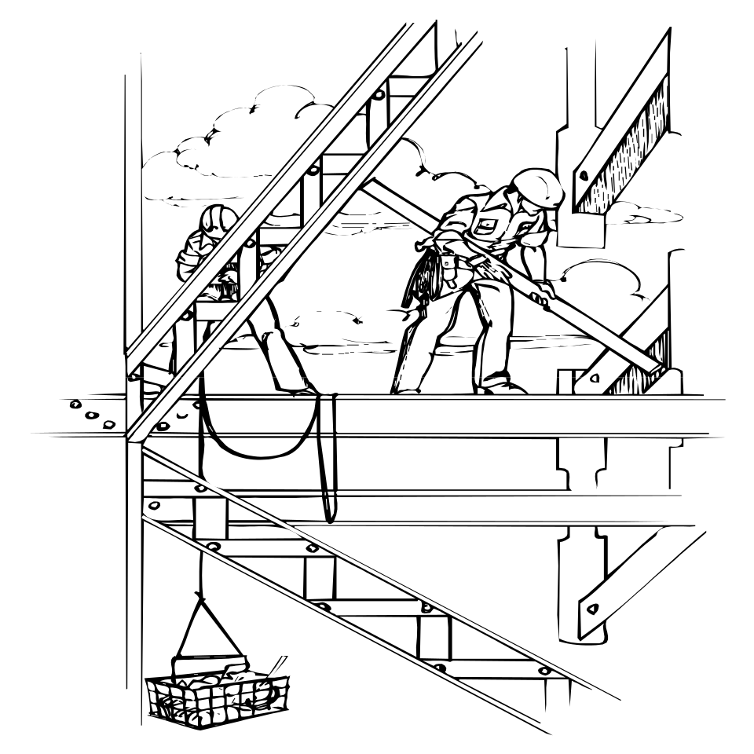
Implementation
Contiguous
Linked

Slide 19
Templates
Up to this point, we have had to rewrite code and redefine the data using a typedef declaration.
The idea of a template allows us to parameterize the type of object held by a class. You can think of a template as similar to a function parameter, only it is a data structure parameter.
Templates allow us to create the container without worrying about what is in the container until we create an instance of the container.

Slide 20
CAUTION!!!!!!!!!
When you write a template class, avoid linker errors by placing the declaration (.h file code) and the implementation (.cpp file code) in one file. That file can be named with the .h extension and then included in the client code.

Slide 21
Declaring Template Types
To declare a value with a template type, a type is provided in angle brackets following the template class name.
List<int> a;
List<double> b;
List<YourType> c;

Slide 22
Contiguous Implementation
    template <class List_entry>
    class List {
    public:
    // methods of the List ADT
    List();
    int size() const;
    bool full() const;
    bool empty() const;
    void clear();
    void traverse(void (*visit)(List_entry &));
    Error_code retrieve(int position, List_entry &x) const;
    Error_code replace(int position, const List_entry &x);
    Error_code remove(int position, List_entry &x);
    Error_code insert(int position, const List_entry &x);

Slide 23
Contiguous Implementation
    protected:
    // data members for a contiguous list implementation
    int count;
    List_entry entry[max_list];
    }; // end class List

Slide 24
insert()
    template <class List_entry>
    Error_code List<List_entry>::
    insert(int position, const List_entry &x)
    {
    if (full())
    return overflow;
    if (position < 0 || position > count)
    return range_error;
    for (int i = count - 1; i >= position; i--)
    entry[i + 1] = entry[i];
    entry[position] = x;
    count++;
    return success;
    }

Slide 25

Performance in a Contiguous List
insert,
remove - O(n)
List(), clear,
empty, full,
size, replace
retrieve - O(1)
traverse - O(?)

Slide 26
Linked Lists
Useful when the number of elements is not known or varies widely during execution
Allows efficient insertion to head, sequential access, no data movement.
a list
link
link
link
link

Slide 27

Linked Implementation
Fred
Harry
225-3465
225-8122
$1,254.65
$2,436.98
Sally
Joe
Larry
335-2145
225-2311
336-8865
$2,332.45
$1,496.00
$2,221.66

Slide 28
Nodes
Harry
225-8122
$2,436.98
    template <class Node_entry>
    struct Node {
    // data members
    Node_entry entry;
    Node<Node_entry> *next;
    // constructors
    Node();
    Node(Node_entry,
    Node<Node_entry> *link = NULL);
    };

Slide 29
List (dynamic allocation)
    template <class List_entry>
    class List
    {
    public:
    // Specifications for the methods of the List
    // Methods replacing compiler-generated defaults.
    ~List();
    List(const List<List_entry> &copy);
    void operator =(const List<List_entry> &copy);
    protected:
    // Data members for the linked list implementation
    int count;
    Node<List_entry> *head;
    // Function to locate list positions
    Node<List_entry> *set_position(int position) const;
    };

Slide 30
Finding a Position in a List
    /*
    Pre: position is a valid position in the List;
    0 <= position < count.
    Post: Returns a pointer to the Node in position.
    */
    template <class List_entry>
    Node<List_entry> *
    List<List_entry>::set_position(int position) const
    {
    Node<List_entry> *q = head;
    for (int i = 0; i < position; i++)
    q = q->next;
    return q;
    }// set_position()

Slide 31
Insertion in a List
    /*
    Post:
    If the List is not full and 0 <= position <= n,
    where n is the number of entries in the List, the function succeeds: Any entry formerly at position
    and all later entries have their position numbers increased by 1, and x is inserted at position of the List.
    Else: The function fails with a diagnostic error code.
    */
    template <class List_entry>
    Error_code List<List_entry>::
    insert(int position, const List_entry &x)

Slide 32
    {
    if (position < 0 || position > count)
    return range_error;
    Node<List_entry> *new_node, *previous, *following;
    if (position > 0)
    {
    previous = set_position(position - 1);
    following = previous->next;
    }
    else
    following = head;
    new_node = new Node<List_entry>(x, following);
    if (new_node == NULL)
    return overflow;
    if (position == 0)
    head = new_node;
    else
    previous->next = new_node;
    count++;
    return success;
    }

Slide 33
In processing a linked list with n entries:
Clear, insert, remove, retrieve and replace are:
O(n)
List, empty, full and size have:
constant time complexity, O(1).

Slide 34
Mutable
Syntax
mutable <variable name>;
Description
Use the mutable specifier to make a variable modifiable even though it is in a const-qualified expression.
Using the mutable Keyword
Only class data members can be declared mutable. The mutable keyword cannot be used on static or const names. The purpose of mutable is to specify which data members can be modified by const member functions. Normally, a const member function cannot modify data members.

Slide 35
Variation, Keep Current Position
    template <class List_entry>
    class List {
    public:
    // Add specs for the methods of the list
    protected:
    int count;
    mutable int current_position;
    Node<List_entry> *head;
    mutable Node<List_entry> *current;
    void set_position(int position) const;
    };

Slide 36
set_position()
    template <class List_entry>
    void List<List_entry>::
    set_position(int position) const
    {
    if (position < current_position) {
    // must start over at head of list
    current_position = 0;
    current = head;
    }
    for ( ; current_position != position;
    current_position++)
    current = current->next;
    }

Slide 37
Variation -- Doubly Linked List
Allows movement either forward or backward
a list
node
node
node
node

Slide 38
Nodes for Doubly Linked Lists
    template <class Node_entry> struct Node
    {
    // data members
    Node_entry entry;
    Node<Node_entry> *next;
    Node<Node_entry> *back;
    // constructors
    Node();
    Node(Node_entry,
    Node<Node_entry> *link_back = NULL,
    Node<Node_entry> *link_next = NULL);
    };

Slide 39
Doubly Linked Lists
    template <class List_entry>
    class List
    {
    public:
    // Specifications for methods of the list ADT.
    // Methods to replace compiler defaults.
    protected:
    // Data members for the doubly-linked list
    int count;
    mutable int current_position;
    mutable Node<List_entry> *current;
    // Function to locate list positions follows:
    void set_position(int position) const;
    };

Slide 40
set_position - Double Linked
    // Pre: position is a valid position in the List:
    // 0 <= position < count.
    // Post: The current Node pointer references the
    // Node at position.*/
    template <class List_entry>
    void List<List_entry>::set_position(int position) const
    {
    if (current_position <= position)
    for ( ; current_position != position; current_position ++)
    current = current->next;
    else
    for ( ; current_position != position; current_position--)
    current = current->back;
    }

Slide 41
insert - Double Linked
    template <class List_entry>
    Error_code
    List<List_entry>::insert(int position, const List_entry &x)
    /*
    Post: If the List is not full and 0 <= position <= n,
    where n is the number of entries in the List, the
    function succeeds:
    Any entry formerly at position and all later entries
    have their position numbers increased by 1 and x is
    inserted at position of the List.
    Else: the function fails with a diagnostic error code.
    */

Slide 42
    { Node<List_entry> *new_node, *following, *preceding;
    if (position < 0 || position > count) return range_error;
    if (position == 0)
    { if (count == 0)
    following = NULL;
    else {
    set_position(0);
    following = current;}
    preceding = NULL;
    }
    else {
    set_position(position - 1);
    preceding = current;
    following = preceding->next; }
    new_node = new Node<List_entry>(x, preceding, following);
    if (new_node == NULL) return overflow;
    if (preceding != NULL) preceding->next = new_node;
    if (following != NULL) following->back = new_node;
    current = new_node;
    current_position = position;
    count++;
    return success;
    }

Slide 43
Performance in a Linked List
clear,
retrieve,
replace,
insert,
remove - O(n)
List(),
empty,
full,
size - O(1)

Slide 44

Contiguous or Linked
Continuous when
  entries are individually very small
  the size of the list is know when the program is written
  few insertions and deletions except at end
  random access is important
Linked when
  the entries are large
  the size of the list is not known in advance
  flexibility is needed in inserting, deleting, and rearranging the entries

Slide 45

Variation -- Head and Tail
Pointers
Allows efficient insertion and removal from both head and tail
a list
node
node
node
node k

Slide 46
Introduction to the Standard Template Library (STL)
object oriented programming - reuse, reuse, reuse
  STL has many reusable components
  Divided into
    containers
    iterators
    algorithms

Slide 47
Introduction to Containers
First class containers
Three types of containers
  sequence containers
  associative containers
  container adapters
Near-containers - similar to containers, without all the capabilities
  C-like arrays
  string
  bitset for maintaining sets of 1/0 flag values
  valarray - high-speed mathematical vector operations
The containers have similar functions
This is only an introduction to STL, a huge class library

Slide 48
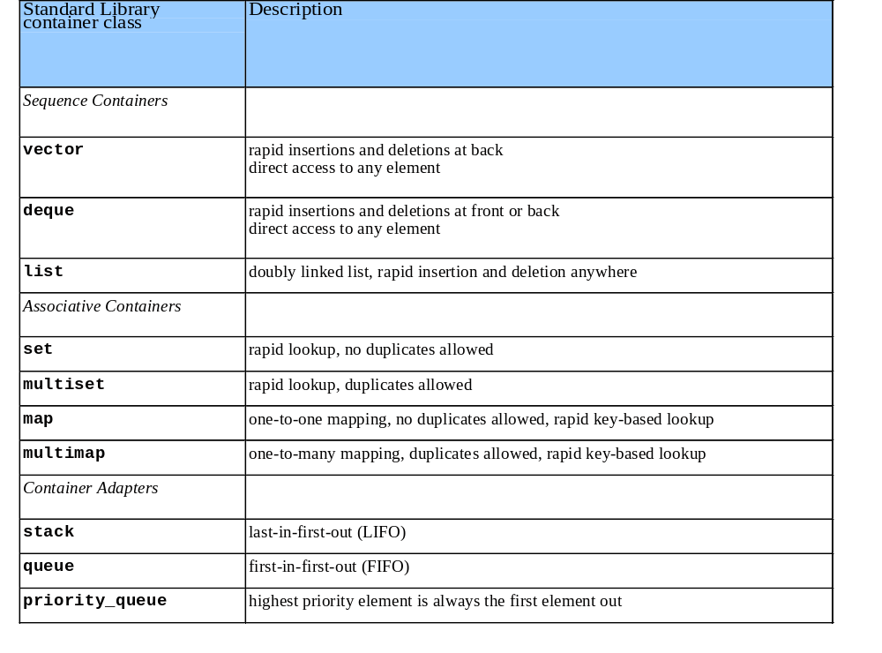
20.1.1 Introduction to Containers (II)

Slide 49
Introduction to Iterators
Iterators are similar to pointers
  point to first element in a container
  iterator operators uniform for all containers
    * dereferences, ++ points to next element
    begin() returns iterator pointing to first element
    end() returns iterator pointing to last element
  use iterators with sequences (ranges)
    containers
    input sequences - istream_iterator
    output sequences - ostream_iterator

Slide 50
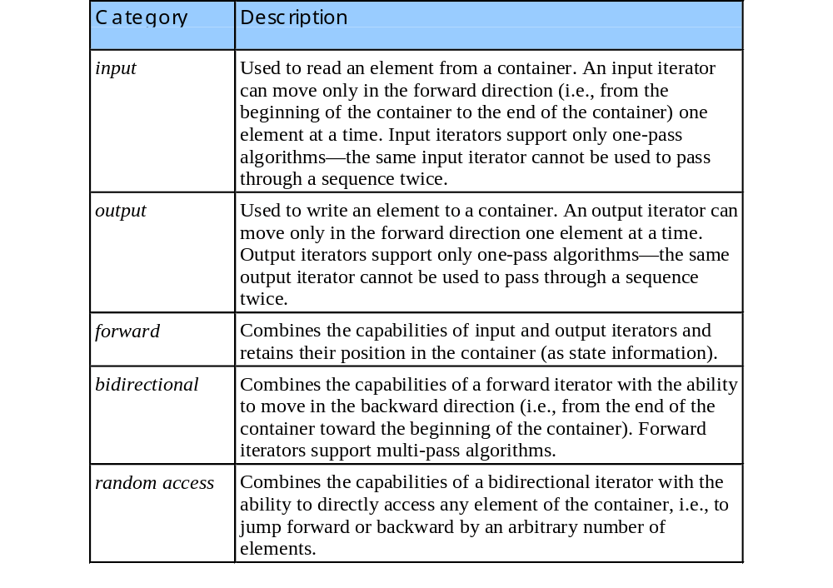
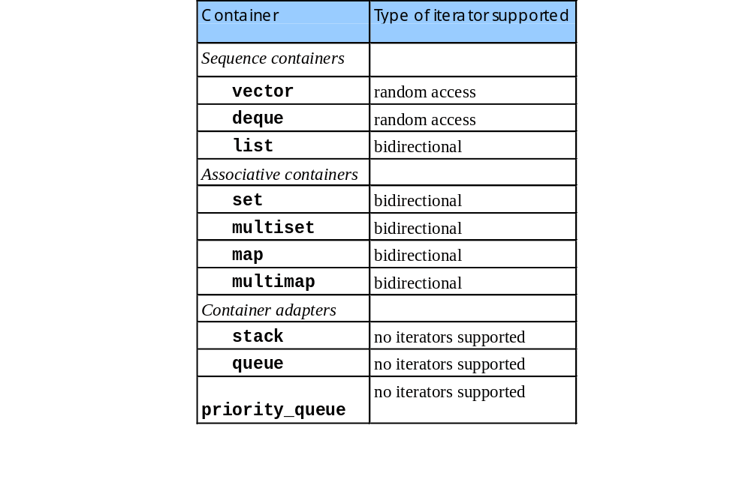
Introduction to Iterators (II)

Slide 51
1 //
2 // Demonstrating input and output with iterators.
3 #include <iostream>
4
5 using std::cout;
6 using std::cin;
7 using std::endl;
8
9 #include <iterator>
10
11 int main()
12 {
13 cout << "Enter two integers: ";
14
15 std::istream_iterator< int > inputInt( cin );
16 int number1, number2;
17
18 number1 = *inputInt; // read first int from standard input
19 ++inputInt; // move iterator to next input value
20 number2 = *inputInt; // read next int from standard input
21
1.1 Initialize iterators
2. Sum numbers
3. Output results
Program Output
22 cout << "The sum is: ";
23
24 std::ostream_iterator< int > outputInt( cout );
25
26 *outputInt = number1 + number2; // output result to cout
27 cout << endl;
28 return 0;
29 }
Enter two integers: 12 25
The sum is: 37

Slide 52
Introduction to Algorithms
STL provides algorithms used generically across containers
  operate on elements indirectly through iterators
  often operate on sequences of elements defined by pairs of iterators
  algorithms often return iterators, such as find()
  premade algorithms save programmers time and effort

Slide 53
Sequence Containers
Three sequence containers
  vector - based on arrays
  deque - based on arrays
  list - robust linked list

Slide 54
vector Sequence Container
vector
  data structure with contiguous memory locations
  use the subscript operator []
  used when data must be sorted and easily accessible
  when memory exhausted
    allocates a larger, contiguous area of memory
    copies itself there
    deallocates the old memory
  has a random access iterators
Declarations
  vectors: vector <type> v;
    type - int, float, etc.
  iterators: vector<type>::const_iterator iterVar;

Slide 55
vector Sequence Container (II)
vector functions, for vector object v
  v.push_back(value) - add element to end (found in all sequence containers).
  v.size() - current size of vector.
  v.capacity() - how much vector can hold before reallocating memory. Reallocation doubles each time.
  vector<type> v(a, a + SIZE) - creates vector v with elements from array a up to (not including) a + SIZE
  v.insert( pointer, value ) - inserts value before location of pointer.
  v.insert( pointer, array , array + SIZE) - inserts array elements (up to, but not including array + SIZE) into vector.

Slide 56
vector Sequence Container (III)
vector functions and operations
  v.erase( pointer )
    remove element from container
  v.erase( pointer1, pointer2 )
    remove elements starting from pointer1 and up to (not including) pointer2.
  v.clear()
    erases entire container.
  v.[elementNumber] = value;
    assign value to an element
  v.at[elementNumber] = value;
    as above, with range checking
    throws out_of_bounds exception

Slide 57
list Sequence Container
list container
  header <list>
  efficient insertion/deletion anywhere in container
  doubly-linked list (two pointers per node)
  bidirectional iterators

Slide 58
list Sequence Container (II)
list functions for listObject and otherObject
  listObject.sort()
    sorts in ascending order
  listObject.splice(iterator, otherObject);
    inserts values from otherObject before location of iterator
  listObject.merge(otherObject)
    removesotherObject and inserts it into listObject, sorted
  listObject.unique()
    removes duplicate elements
  listObject.swap(otherObject);
    exchange contents
  listObject.assign(otherobj.iter1,otherobj.iter2)
    replaces contents with elements in range of iterators
  listObject.remove(value)
    erases all instances of value

Slide 59
1 //
2 // Testing Standard Library class list
3 #include <iostream>
4
5 using std::cout;
6 using std::endl;
7
8 #include <list>
9 #include <algorithm>
10
11 template < class T >
12 void printList( const std::list< T > &listRef );
13
14 int main()
15 {
16 const int SIZE = 4;
17 int a[ SIZE ] = { 2, 6, 4, 8 };
18 std::list< int > values, otherValues;
19
20 values.push_front( 1 );
21 values.push_front( 2 );
1. Function prototype
1.1 Define and initialize variables
2. Function calls
2.1 sort
22 values.push_back( 4 );
23 values.push_back( 3 );
24
values contains: 2 1 4 3
25 cout << "values contains: ";
26 printList( values );
27 values.sort();
values after sorting contains: 1 2 3 4
28 cout << "\nvalues after sorting contains: ";
29 printList( values );
30
31 otherValues.insert( otherValues.begin(), a, a + SIZE );
32 cout << "\notherValues contains: ";
otherValues contains: 2 6 4 8
33 printList( otherValues );

Slide 60
34 values.splice( values.end(), otherValues );
35 cout << "\nAfter splice values contains: ";
36 printList( values );
After splice values contains: 1 2 3 4 2 6 4 8
37
38 values.sort();
39 cout << "\nvalues contains: ";
40 printList( values );
41 otherValues.insert( otherValues.begin(), a, a + SIZE );
42 otherValues.sort();
values contains: 1 2 2 3 4 4 6 8
otherValues contains: 2 4 6 8
43 cout << "\notherValues contains: ";
44 printList( otherValues );
45 values.merge( otherValues );
46 cout << "\nAfter merge:\n values contains: ";
47 printList( values );
After merge:
values contains: 1 2 2 2 3 4 4 4 6 6 8 8
otherValues contains: List is empty
48 cout << "\n otherValues contains: ";
49 printList( otherValues );
50
51 values.pop_front();
52 values.pop_back(); // all sequence containers
53 cout << "\nAfter pop_front and pop_back values contains:\n";
54 printList( values );
After pop_front and pop_back values contains:
2 2 2 3 4 4 4 6 6 8
2.2 splice
2.3 merge
2.4 pop
2.5 unique
2.6 swap
55
56 values.unique();
57 cout << "\nAfter unique values contains: ";
58 printList( values );
After unique values contains: 2 3 4 6 8
59
60 // method swap is available in all containers
61 values.swap( otherValues );
After swap:
values contains: List is empty
otherValues contains: 2 3 4 6 8
62 cout << "\nAfter swap:\n values contains: ";
63 printList( values );
64 cout << "\n otherValues contains: ";
65 printList( otherValues );
66

Slide 61
67 values.assign( otherValues.begin(), otherValues.end() );
68 cout << "\nAfter assign values contains: ";
After assign values contains: 2 3 4 6 8
69 printList( values );
70
71 values.merge( otherValues );
72 cout << "\nvalues contains: ";
73 printList( values );
values contains: 2 2 3 3 4 4 6 6 8 8
74 values.remove( 4 );
75 cout << "\nAfter remove( 4 ) values contains: ";
76 printList( values );
After remove( 4 ) values contains: 2 2 3 3 6 6 8 8
77 cout << endl;
78 return 0;
79 }
80
81 template < class T >
2.7 assign
2.8 remove
3. Function definition
82 void printList( const std::list< T > &listRef )
83 {
84 if ( listRef.empty() )
85 cout << "List is empty";
86 else {
87 std::ostream_iterator< T > output( cout, " " );
88 std::copy( listRef.begin(), listRef.end(), output );
89 }
90 }

Slide 62
values contains: 2 1 4 3
values after sorting contains: 1 2 3 4
otherValues contains: 2 6 4 8
After splice values contains: 1 2 3 4 2 6 4 8
values contains: 1 2 2 3 4 4 6 8
otherValues contains: 2 4 6 8
After merge:
values contains: 1 2 2 2 3 4 4 4 6 6 8 8
otherValues contains: List is empty
After pop_front and pop_back values contains:
2 2 2 3 4 4 4 6 6 8
After unique values contains: 2 3 4 6 8
After swap:
values contains: List is empty
otherValues contains: 2 3 4 6 8
After assign values contains: 2 3 4 6 8
values contains: 2 2 3 3 4 4 6 6 8 8
After remove( 4 ) values contains: 2 2 3 3 6 6 8 8
Program Output

Slide 63
deque Sequence Container
deque ("deek") - double-ended queue
  load <deque>
  indexed access using []
  efficient insertion/deletion in front and back
  non-contiguous memory: "smarter" pointers
same basic operations as vector
  adds push_front / pop_front - insertion/deletion at beginning of deque

Slide 64

STL list
a combination of head and tail pointers and double links.
a list
node
node
node
node

Slide 65
Summary of STL list Operations
Constructors and Assignments
  list<T> l; //default
  list<T> v (aList); // copy
  l = aList
  l.swap(aList)

Slide 66
Summary of STL list Operations
Element Access
  l.front()
  l.back()
Size
  l.empty()
  l.size()

Slide 67
Summary of STL list Operations
Insertion and Removal
  l.push_front(value)
  l.push_back(value)
  l.insert(iterator,value)
  l.pop_front()
  l.pop_back()
  l.erase(iterator)
  l.erase(iterator, iterator)
  l.remove(value)

Slide 68
Summary of STL list Operations
Iterators
  list<T>::iterator itr
  l.begin()
  l.end()

Slide 69
Summary of STL list Operations
Miscellaneous
  l.reverse()
  l.sort() //Ascending order
  l.sort(comparison) //Ascending or descending order
  l.merge(list)

Slide 70
Declaring a new STL list
You must include the header file
  #include <list>

Slide 71
Declaring a new STL list
Constructors
  list <int> list_one;
  list<Widget *> list_two;
  list<Widget> list_three;
  list <int> list_four (list_one);
  list<Widget> list_five;
  list_five = list_three;
  list_one.swap (list_four);

Slide 72
Iterators
A pointer-like object used to cycle through all the elements stored in a container.
Provided for each container class in the standard library.
Since an iterator is an object, iterators must be instantiated.
Iterator classes are provided for most container classes.

Slide 73
iterator find(iterator first,
iterator last,
T & value)
{ while (first != last && *first != value)
++first;
return first;
}
element
element
element
element
element
element
1
2
3
4
5
6
first
last

Slide 74
iterator find(iterator first,
iterator last,
T & value)
{ while (first != last && *first != value)
++first;
return first;
}
element
element
element
element
element
element
1
2
3
4
5
6
first
last

Slide 75
iterator find(iterator first,
iterator last,
T & value)
{ while (first != last && *first != value)
++first;
return first;
}
element
element
element
element
element
element
1
2
3
4
5
6
first
last

Slide 76
aList
element
element
element
element
element
element
1
2
3
4
5
6
aList.begin()
aList.end()
list<int>::iterator where = find(aList.begin(), aList.end(), 7)

Slide 77
Requirements for an Iterator
An iterator can be compared for equality to another iterator. They are equal when they point to the same position, and are otherwise not equal.

Slide 78
Requirements for an Iterator
An iterator can be dereferenced using the * operator, to obtain the value being denoted by the iterator. Depending upon the type of iterator and variety of underlying container, this value can also sometimes be used as the target of an assignment in order to change the value being held by the container.

Slide 79
Requirements for an Iterator
An iterator can be incremented, so that it refers to the next element in sequence, using the operator ++.

Slide 80

Using the STL
using namespace std;
must be included in your code at the time you specify the include files. This is necessary to avert conflicts with other library files.

Slide 81
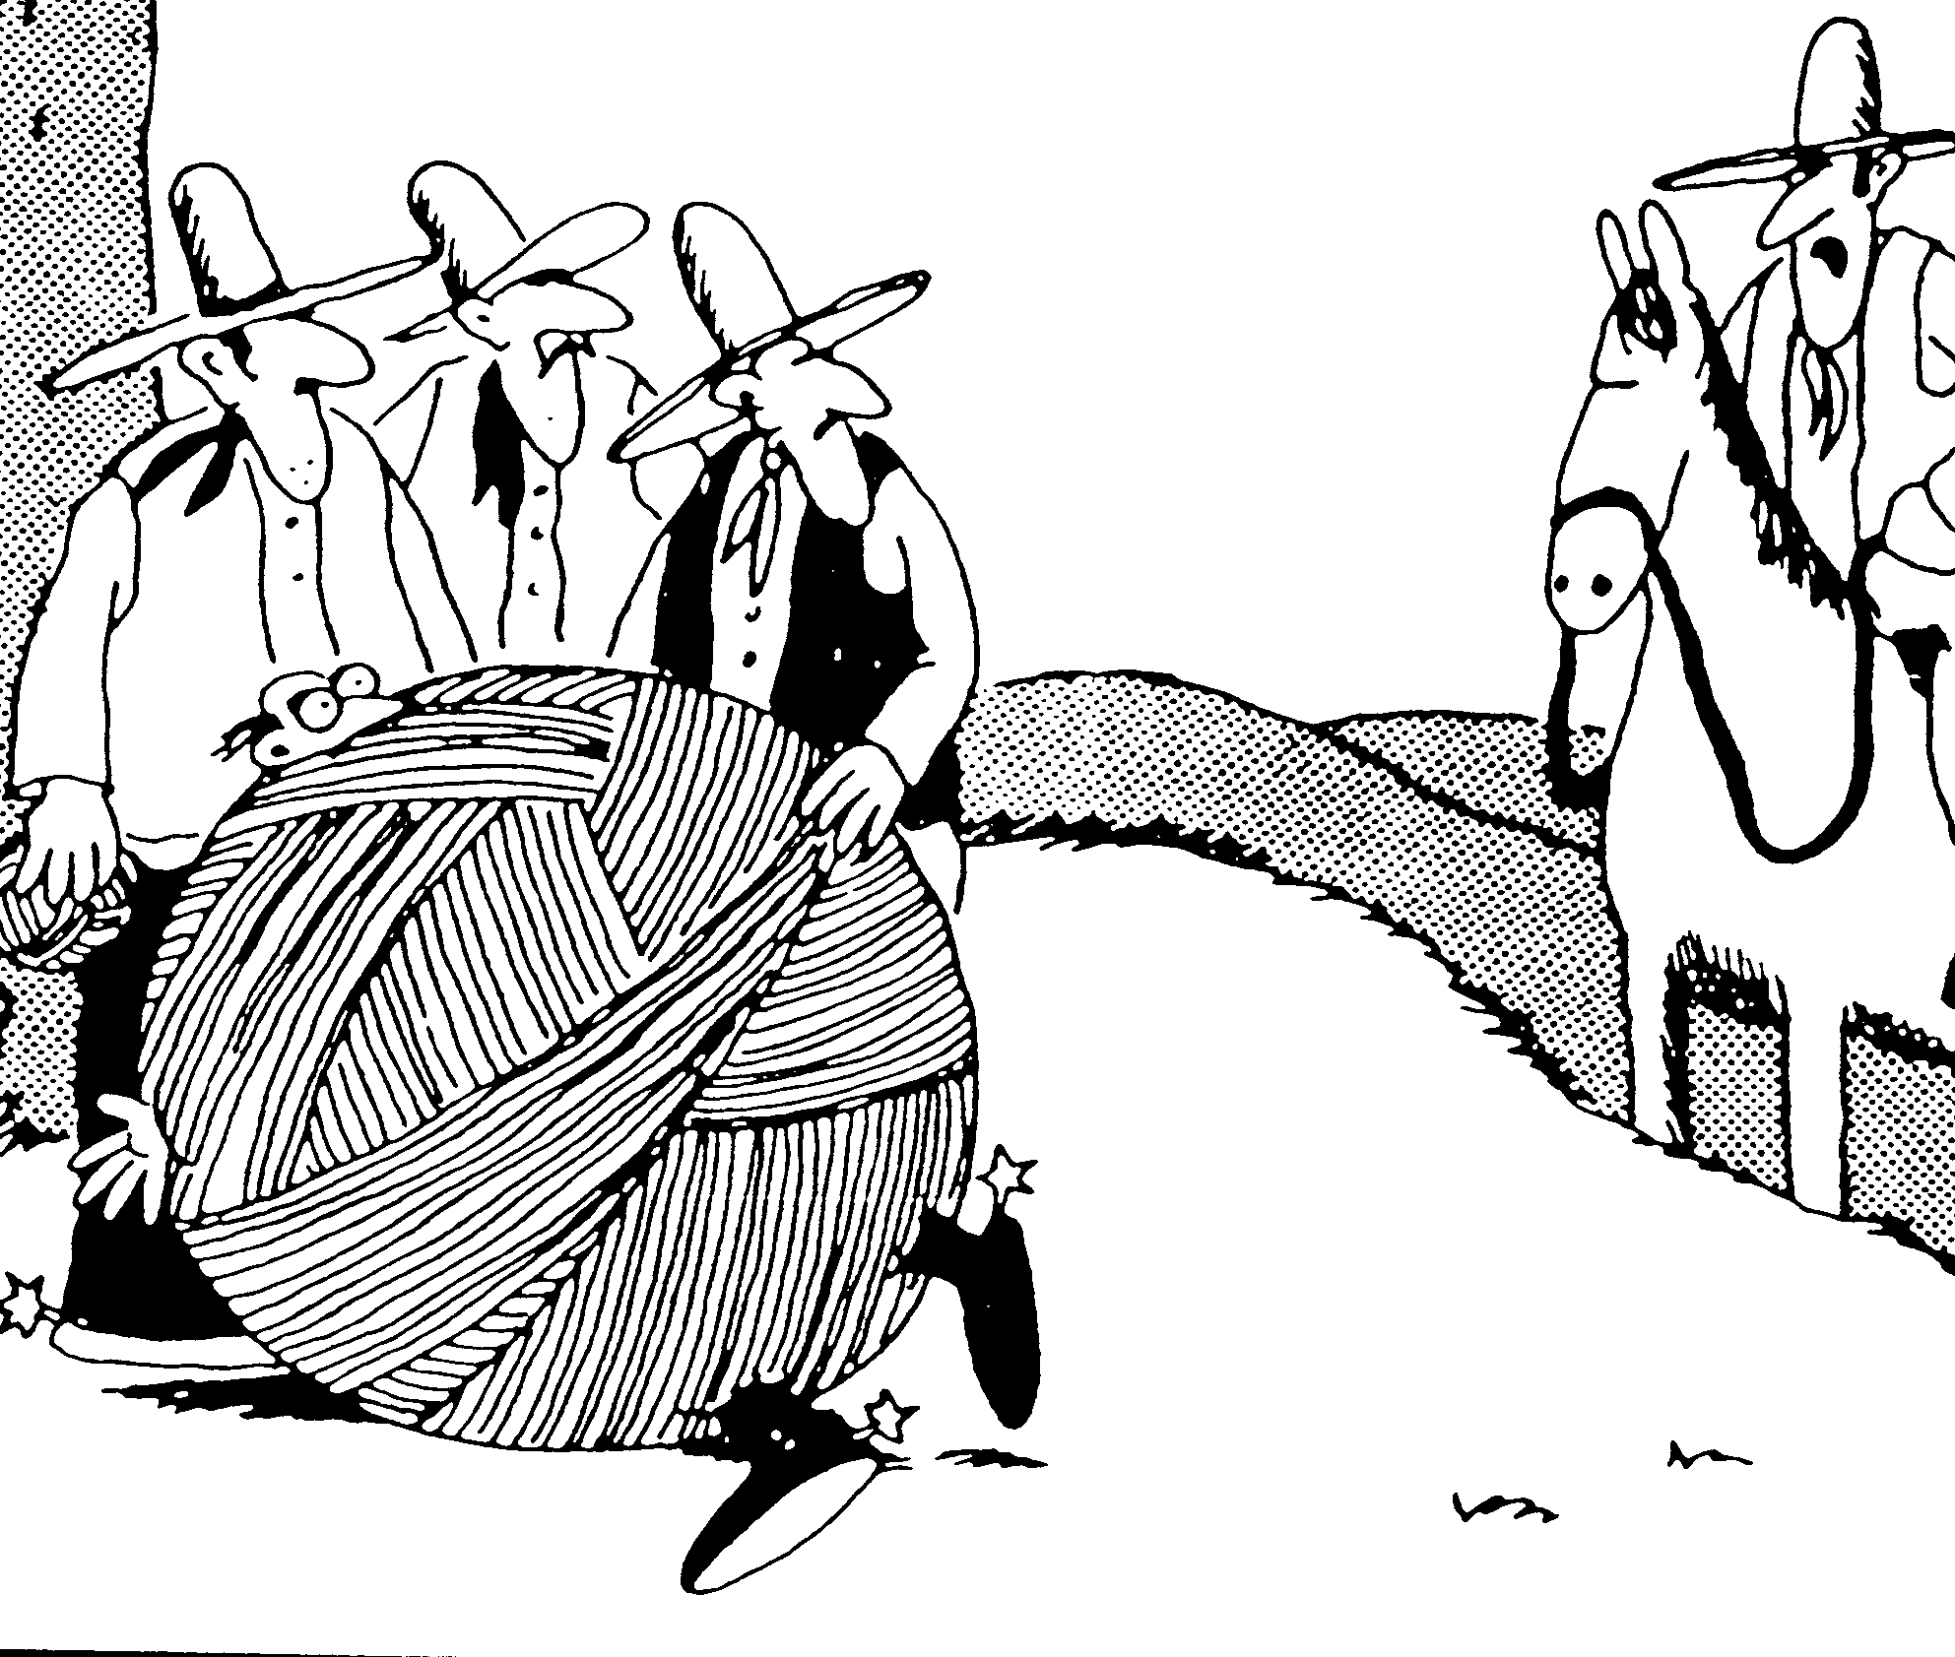
"Hang him, you idiots! Hang him!..'String-him-up' is an abstraction!"

Slide 82

Characters in C++
In C++ a character is simply a form of integer. Arithmetic and relational operations can be performed on characters, just as on integers.
int isUpperCase(char c)
{
//return true if c is upper case
return(c >= 'A') && (c <= 'Z');
}

Slide 83
Characters in C++
In C++ a character is simply a form of integer. Arithmetic and relational operations can be performed on characters, just as on integers.
char upperToLower(char c)
{
if(isUpperCase(c))
return(c - 'A') + 'a';
return c;
}

Slide 84
Primitive C++ Strings
In C++ a literal string is simply a pointer to a sequence of characters. No movement of characters is performed in the following, only an assignment of pointers
char * p;
p = "hello world!";
hello world!
p

Slide 85
Pointers Can be Subscripted
Like all pointers, pointers to characters can be subscripted, and thus literals can be modified.
p[0] = 'y';
p[5] = p[6];
p[6] = ' ';
p[8] = 'i';
p[10] = '\?';
Changes the test array into yellow oil?!
No checks are made on the validity of pointer subscripts. Can even be negative.

Slide 86
Null Character Termination
Strings are terminated with a null character, a character with value zero.
char * p;
p = "hello world!";
The literal contains 13 characters, 12 printing characters and one null character. The programmer must remember the null character, and make sure space is allocated to hold it.
h
e
l
l
o
w
o
r
l
d
!
\0

Slide 87
Manipulation of Strings as Arrays
Since a string is simply an array, we can perform operations (such as string length) using array operations.
int CstringLength(const char * str)
{ // compute number of non-null
// characters in a C string
int i = 0;
while (str[i] != ‘\0’)
i++;
return i;
}

Slide 88
The STL string data abstraction
If we were to create our own ADT for strings, we would want:
Bounds checking on subscription, copies, and catenation.
Assignments which result in copies.
Comparisons performed using relational operators.
High level operations such as substrings, pattern matching.

Slide 89
Improving strings with abstraction
High level operations, such as append, catenate, insert and replace
Assignment of string values results in copies
Comparisons use relational operators such as <= and >, comparing string values, not addresses

Slide 90
Example: Palindrome Testing
bool isPalindrome_type1(string & aString)
// tests to see if aString is palindrome
{
string temp; //declare temporary
temp = aString; // duplicate argument
reverse(temp.begin(), temp.end());
return temp == aString;
}
aString
“civic”
temp
“civic”
temp
“civic”

Slide 91
Example: Palindrome Testing
bool isPalindrome_type2(string & aString)
// tests to see if aString is palindrome
{
string allLow(aString);
transform(aString.begin(), aString.end(),
allLow.begin(), tolower);
return isPalindrome_type1(allLow);
}
void transform(iterator start, iterator stop,
iterator to, char fun(char)))
{ while (start != stop)
*to++ = fun(*start++); }

Slide 92
aString
“Civic”
allLow
“Civic”
allLow
“civic”
bool isPalindrome_type2(string & aString)
// tests to see if aString is palindrome
{
string allLow(aString);
transform(aString.begin(), aString.end(),
allLow.begin(), tolower);
return isPalindrome_type1(allLow);
}
void transform(iterator start, iterator stop,
iterator to, char fun(char)))
{ while (start != stop)
*to++ = fun(*start++); }

Slide 93
Example: Palindrome Testing
bool isPalindrome_type3(string & aString)
{
string punctChars = “ ,.!?”;
string temp = remove_all(aString, punctChars);
return isPalindrome_type2(temp);
}
aString
“Able was I ere I saw Elba.”
temp
“AblewasIereIsawElba”

Slide 94
txt
“Able was I ere I saw Elba.”
spaces
“ ,.!?”
result
A
b
l
e
w
a
s
I
ereIsawElba
string remove_all(string & txt, string & spaces)
{
string result;
int textLen = txt.length();
int spacesLen = spaces.length();
for(int i=0; i<textLen; i++){
string aChar = text.substr(i,1);
int location = spaces.find(aChar, 0);
if((location < 0) || (location>=spacesLen))
result += aChar; //not found
}
return result;
}
26
5

Slide 95
Example: Palindrome Testing
void pal_test(string & aString)
{
cout << “string:” << aString;
if (isPalindrome_type1(aString))
cout << “is a type 1 palindrome\n”;
else if (isPalindrome_type2(aString))
cout << “is a type 2 palindrome\n”;
else if (isPalindrome_type3(aString))
cout << “is a type 3 palindrome\n”;
else
cout << “is not a palindrome\n”
}

Slide 96
Creation of strings
an uninitialized string
  string a;
initialized with a string value
  string b(“one two”);
alternative style of initialization
  string c = “three four”;
copy constructor
  string e (c);

Slide 97

Subscripts
[ ]
String values may be subscripted and used to either obtain or set a value.
b = “five six”;
b[0] = ‘h’;
// b is now “hive six”

Slide 98
substr(a,b)
The member function substr() returns a string that represents a portion of the current string.
cout << s4.substr(1,3) << endl;
string s4 = “Reno, Nevada”;
Outputs a string three characters long, beginning at position one of string s4. (zero based)
eno

Slide 99
c_str();
Returns a C-style pointer. Most often used when a string value must be passed to a function that expects an older style character array.
string fileName;
...
File * fin = fopen(fileName.c_str(), “w”;

Slide 100
length()
Returns an integer value that describes the number of characters currently being held by a string.
cout << myString.length() << endl;

Slide 101
resize()
This allows the memory used for a string to grow or shrink. When memory decreases, data may be lost. When memory increases, new characters are inserted.
myString.resize(23, ‘\0’);
Increases the size of myString to 23 cells, placing the null character in new cells.

Slide 102
empty()
Returns true if the string contains no characters. Usually faster than testing the length against zero.
if (myString.empty())
cout << “string is empty” << endl;

Slide 103
Assignment and Append
One string value can be concatenated on to the end of another using the addition assignment operator.
string studentName = “Betty”;
studentName += “sue”;
// betty is now holding Bettysue
The addition operator by itself can be used to concatenate two strings to yield a new string, without modifying either argument.

Slide 104
Iterators
The member functions begin() and end() return beginning and ending random-access iterators for the string. The values denoted by the iterators will be individual characters.
string::iterator itr = aString.begin();
for(; itr != aString.end(); ++itr)
...

Slide 105

insert()
Takes as arguments a position and a string and inserts the string into the given position.
string petName = “Green Turtle”;
petName.insert(5,” or Pink“);
cout << petName << endl;
Results in an output of:
Green or Pink Turtle

Slide 106

remove()
Takes two integer arguments, a position and a length, and removes the characters specified.
string partName = “hammer”;
partName.remove(3,3);
cout << partName << endl;
Displays: ham

Slide 107
replace()
Takes two similar integer arguments as well as a string, and replaces the indicated range with the string.
string streetName = “Riverside”;
streetName.replace(6,3,”torm”);//0 based
cout << streeName << endl;
Displays: Riverstorm

Slide 108
Using Relational Operators
Two string values will be checked using relational operators. Given the assignments:
string anne = “anne”;
string allen = “allen”;
string alfred = “alfred”;
string annette = “annette”;
string betty = “anne”;

Slide 109
Using Relational Operators
Two string values will be checked using relational operators. Given the assignments:
string anne = “anne”;
string allen = “allen”;
string alfred = “alfred”;
string annette = “annette”;
string betty = “anne”;
The following assertions will all be true.
assert(anne == anne);
assert(alfred < allen);
assert(annette >= anne);
assert(anne == betty);

Slide 110
Searching Operations
// 0123456789012345678901234567890123
s1 = “it was the best of times, it was”;
cout << s1.find(“times”); // 19
cout << s1.find(“it”, 20)<< endl; // 26
i = s1.find_first_of(“aeiou”);
j = s1.find_first_not_of(“aeiou”, i)

Slide 111
Useful Generic Algorithms
reverse(iterator start, iterator stop)
reverse text in the give portion of string
count(iterator start, iterator stop,
target value, int & counter)
count elements that match target value, incrementing counter
count_if(iterator start, iterator stop,
unary, int & counter)
count elements that satisfy function

Slide 112
Useful Generic Algorithms
transform(iterator start, iterator stop
iterator destination, unary function)
transform text using unary function source, placing into destination
find(iterator start, iterator stop,
value)
find value in string, returning iterator for location
find_if(iterator start, iterator stop,
unary function)
find value for which function is true, returning iterator for location

Slide 113
Useful Generic Algorithms
replace(iterator start, iterator stop
target value, replacement value)
replace target character with replacement character
replace_if(iterator start, iterator stop, unary fun, replacement value)
replace characters for which function is true with replacement character
sort(iterator start, iterator stop)
places characters into ascending order

Slide 114
Input/Output Routines
string aString = “Find Average Word Length\n”;
cout << aString;
string aWord;
int count = 0;
double size = 0;
while (cin >> aWord) {
size += aWord.length();
count++;
}
cout << “Average word length:”
<< (size/count) << endl;

Slide 115
Input/Output Routines
string aLine;
while (cin.getline(aLine, MAX, ‘\n’))
...

Slide 116
Typical Implementation
A simplified string abstraction will be presented

Slide 117
class string{
public:
typedef char * iterator;
string ();
string (char *);
string (string &);
~string ();
iterator begin ();
bool empty ();
iterator end ();
int find (string &, int);
int find_first_of (string &, unsigned int);
int find_first_not_of (string &,
unsigned int);
string substr (unsigned int, unsigned int);
void remove (unsigned int, unsigned int);

Slide 118
void replace (unsigned int, unsigned int,
string &);
void resize (unsigned int, char);
char & operator [] (unsigned int);
void operator = (string &);
void operator += (string &);
friend bool operator == (string &, string &);
friend bool operator != (string &, string &);
friend bool operator < (string &, string &);
friend bool operator <= (string &, string &);
friend bool operator > (string &, string &);
friend bool operator >= (string &, string &);
protected:
char * buffer;
unsigned short int bufferLength;

Slide 119
Run-time Stack
Heap
aString
buffer
C A T \0
buffer
Length
3

Slide 120
Constructors
Constructors should be able to create a string from:
Default
A literal string as an initial value
Another string value

Slide 121
Constructors
Constructors should be able to create a string from:
Default
A literal string as an initial value
Another string value
string one();
string two = “this is two”;
string three = two;
string four(“this is four”);
string five(four);

Slide 122
Commonality
Whenever possible, seek out repeated or common operations, and factor the code performing these operations into their own routines.

Slide 123
Dynamic Allocation
Instances of the string ADT maintain an internal buffer. The length of this buffer must grow and shrink as operations are perfomed on the string. Thus we cannot allocate a fixed size array of characters for this purpose.
The space for the array must be dynamically allocated.
The function resize() will be used to do this.

Slide 124
void string::resize(unsigned int newLength,
char pad)
{
// if no current buffer, length is zero
if (buffer == 0)
bufferLength = 0;
// case 1, getting smaller
if (newLength < bufferLength)
buffer[newLength] = ‘\0’; //just add null
else { // case 2 larger, allocate new buffer
int i;
char * newbuffer = new char[newLength +1];
assert (newbuffer != 0);
// first copy existing characters
for(i=0;
i<bufferLength && buffer[i] != ‘\0’;
i++)
newbuffer[i] = buffer[i];

Slide 125
// then add pad characters
for(; i < newLength; i++)
newbuffer[i] = pad;
// add terminating null character
newbuffer[i] = ‘\0’;
// free up old area, assign new
if (buffer != 0)
delete [] buffer;
buffer = newbuffer;
bufferLength = newLength;
}
}

Slide 126
Default Constructor
string::string()
{
bufferLength = 0;
resize (0, ‘ ‘);
}

Slide 127

Constructors From a Literal
string::string(const char * initialText)
{
bufferlength = 0;
resize (strlen(initialText), ‘ ‘);
strcpy (buffer, initialText);
}

Slide 128
Copy Constructor
string::string(string & str)
{
buffer = 0;
// allocate buffer of correct size
resize(str.length(), ‘ ‘);
// then fill with values
strcpy(buffer, str.buffer);
}

Slide 129
Operators - Functions/Methods
An ordinary function is normally not permitted access to the protected portions of the class.
Implicit conversions, say from integer to float, will be performed for both right and left argument if the operator is defined in functional form, but only for the right if member function.

Slide 130
Assignment Operator
void string :: operator = (string & str)
// reassign string to the argument value
{
resize (str.length, ‘ ‘);
strcpy (buffer, str.buffer);
}

Slide 131
delete Operator
Because space that is dynamically allocated is not tied to procedure entry and exit, it is the responsibility of the programmer to see that it is disposed of when no longer useful. This is performed using the function delete. Once freed, memory is “recycled” by the system for use in subsequent allocation requests.
delete [] buffer;
Whenever dynamic memory is allocated, thought should be given to how and when it will be freed.

Slide 132

Destructors
Just as constructors tie creation and initialization, and thus assist in the birth of new objects, the C+ language also provides a facility to assist in any “bookkeeping” tasks that must be performed at the termination of an object. This facility is called a destructor.
string::~string()
{
delete [] buffer;
}

Slide 133
Destructors
string::~string()
{
delete [] buffer;
}
Destructors are almost never directly invoked by the user; instead they are implicitly called by the run-time system.
Note that this destructor is invoked when the string is to be deleted. Dynamic memory is only freed using the delete operator.

Slide 134
Computing the Length
A simple operation we might want to perform on a string is to compute the length of the string.
int string::length()
{
for (int i = 0; i < bufferLength; i++)
if (buffer[i] == ‘\0’
return i;
return bufferLength;
}

Slide 135
Empty?
bool string::empty()
// see if string is empty
{
return buffer[0] == ‘\0’;
}

Slide 136
Subscripting
Unlike the C++ subscript operation, subscripts in our ADT will check the index for validity. Here is a first stab at a solution.
char & string::operator [](unsigned int index)
{
assert(index <= bufferlength);
return buffer[index];
}

Slide 137
Subscripting
char & string::operator [](unsigned int index)
{
assert(index <= bufferlength);
return buffer[index];
}
Note the way in which it is declared. Subscript is an operator. The name of the operator is []. The argument of the subscript is declared as the argument to the subscript function. The return type is a reference, an alias for the character location. This allows: aString[3] = ‘d’;

Slide 138

Possible Problem - Clobbered null
Returning a reference allows a subscript to appear on the left side of an assignment statement:
s[3] = ‘w’;
We want to be able to access the null character using subscript, (loops require this) but not to clobber the null.

Slide 139

An Alternate[] Operator
char nothing; //global variable holding null
char & string::operator [](unsigned int index)
{
if(index >= CstringLength(buffer)){
nothing = ‘\0’;
return nothing;
}
return buffer[index];
}

Slide 140
substr()
string string::substr(unsigned int start;
unsigned int len)
// return a subportion of string
{
assert (start + len <= length());
string sub; // create new value
sub.resize(len, ‘ ‘); // resize accordingly
for (int i = 0; i < len; i++)
sub[i] = buffer[start + i]; //copy chars
return sub;
}

Slide 141
Iterators
A typedef statement appears in the class definition, defining the name iterator as a synonym for a pointer to an array of char values. This allows variables to be declared using the iterator keyword in a fully qualified name, without requiring the programmer to know how such iterators are implemented.
string::iterator start = aString.begin();
string::iterator stop = aString.end();
for(;start != stop; ++ start)
...

Slide 142

Iterators
char * string::begin()
// return starting iterator, point to buffer
{
return buffer;
}
C
A
T
\0
char * string end()
// return past-the-end iterator
{
return buffer + length();
}

Slide 143
remove()
void string::remove(unsigned int start,
unsigned int len)
// remove len characters from given location
{
int stop = start + len;
// move characters into place
while ((stop < bufferLength) &&
(buffer[stop] != ‘\0’))
buffer[start++] = buffer[stop++];
buffer[start] = ‘\0’;
}

Slide 144
insert()
void string::insert(unsigned int position,
string & newText)
// insert text, starting at position
{ int len = length(); // current length
int ntLen = newText.length(); // to add
int newLen = len + ntLen; // new length
// if necessary, resize buffer
resize(newLen, ‘\0’);
// move existing characters over
for(int i= len; i > position; i--)
buffer[i+ntLen] = buffer[i];
// insert new characters
for(int i = 0; i < ntLen; i++)
buffer[position + i] = newText[i]; }

Slide 145
replace()
void string::replace(unsigned int start,
unsigned int len,
string & newText)
// replace start to start+len with new text
{
remove (start, len);
insert (start, newText);
}
Note implementation using simpler functions.

Slide 146
operator +=
void string::operator += (string & right)
// append argument string to end of current
{
insert (length(), right);
}

Slide 147
operator +
string operator + (string & left,
string & right)
// catenate two string values, forming new
{
string clone(left); // copy left argument
clone += right; // append right argument
return clone; // return result
}

Slide 148
Comparisons
The relational and equality operators are probably better defined as simple operators, not as member functions. This permits conversions to be performed in either left or right argument.
sue > “sammy”
“allan” <= sue
The six functions are all very similar. We can simplify tasks considerably by defining a single comparisons function, and then implementing each of the six as a call on this single function.

Slide 149
The Comparison Function
int strcmp(char * p, char * q)
{
while((*p != ‘\0’)&&(*p==*q))
{
p++;
q++;
}
return *p-*q;
}

Slide 150
Comparison Functions
int operator <(string &left, string &right)
{ return strcmp(left.buffer, right.buffer) < 0);}
int operator <=(string &left, string &right)
{ return strcmp(left.buffer, right.buffer) <= 0);}
int operator !=(string &left, string &right)
{ return strcmp(left.buffer, right.buffer) != 0);}
int operator ==(string &left, string &right)
{ return strcmp(left.buffer, right.buffer) == 0);}
int operator <(string &left, string &right)
{ return strcmp(left.buffer, right.buffer) < 0);}
int operator >=(string &left, string &right)
{ return strcmp(left.buffer, right.buffer) >= 0);}

Slide 151
find()
int string::find(string & target,
unsigned int start)
// search for target string as a substring
{
int targetLength = target.length();
// stop is last possible starting pos
int stop = length() - targetLength;
for(int i = start; i <= stop; i++)
if(substr(i, targetLength) == target)
return i;
// no match found
return bufferLength;
}

Slide 152
Creating a linked list in an array:
const int max = 100
int entry[max], int link[max], avail;
for (int i = 0; i<= max-2; i++)
link[i] = i + 1;
link[max-1] = -1; // -1 means null
avail = 0;
int getnode(int avail)
{
if ( avail > -1)
{
int p = avail;
avail = link[avail];
return p;
}
else return underflow;
}
void freenode(int avail, int p)
{
link[p] = avail,
avail = p;
}

Slide 153

At Last, Chapter 6 Ends
Did you get all of that?

